Slide 1

San Diego Ocean Water Quality
DSE241 Data Viz Project Proposal
Alejandro Hohmann

Slide 2

Hypothesis: Rain events lead to increase in bacteria in San Diego’s ocean shore water
Runoff
Sewer overflow
Rain sweeps the streets and carries trash to the ocean
San Diego and Tijuana share a “boundary” but not sewage standards
San Diego Ocean Water Quality

Slide 3
Water Quality and Precipitation Data
San Diego’s Ocean Monitoring Program (OMP)
sample_id | station_id | sample_date_time | parameter | value
2001018683 | S11 | 2020-01-01 | entero | 220
2001018683 | S11 | 2020-01-01 | salinity | 33.409
2001029022 | C7 | 2022-12-29 | fecal | 2
2001029022 | C7 | 2022-12-29 | temp | 12.18C
15,000 samples | 104 sites | 2 years* | 10 measures | 8 scales
*30+ years of data available
National Weather Service
Geospatial Precipitation Data with corresponding latitude/longitude & date-time

Slide 4
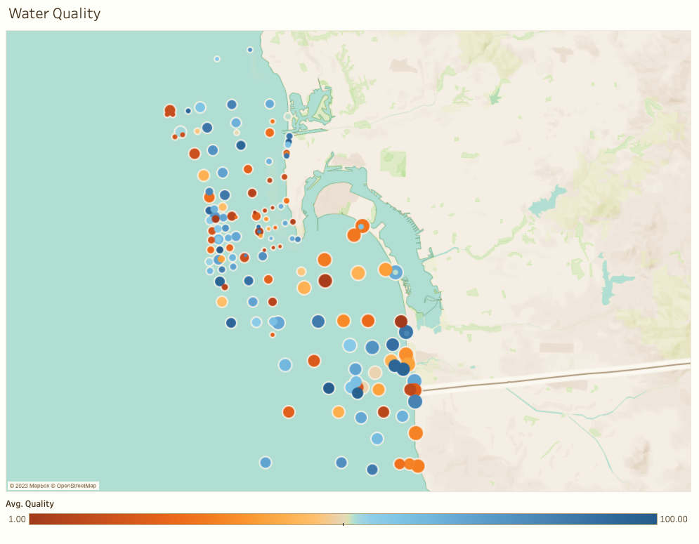
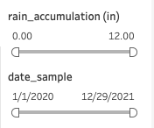
Data Visualization Solution
Dynamic dashboard that demonstrates measurement levels at different rain accumulations (slider) and dates (slider_
User can toggle between 8 measurements and zoom/navigate to different areas
Built with Python on top of Plotly/Dash and GeoPandas
idiom: heat map
mockup

Slide 5
BUSINESS OPPORTUNITIES ARE LIKE BUSES. THERE'S ALWAYS ANOTHER ONE COMING.
For Professional and Recreational Users
City Professionals who must prepare for bacterial blooms
Biologists who want to understand interaction with wildlife
Surfers who want to know if a certain amount of rain (actual or forecast) poses a bacterial threat
“
”
- Richard Branson
San Diego Ocean Water Quality

Slide 6



Contact
Alejandro Hohmann
ahohmann@ucsd.edu
github.com/gojandrooo
San Diego Ocean Water Quality

